Slide 1
“Implementing Sustainable Water Management”
A Proposal for Subbasin Hydro Zones
Enhanced Geologic Water Resource Management through Targeted Continuous Measurement
Matt Angell: San Joaquin Valley Farmer, Partners in Madera Pumps, Water Informatics, Land Scan Intelligent Land AI

Slide 2
Madera Subbasin: Geography, Scale and Stakeholders
Located in the San Joaquín valley, part of California’s 5-million-acre Central Valley
Madera County is geologically diverse:
  50% valley floor 50% Foothill/Mountain, bordering Yosemite National Forest
  Center of California –lies just south of the Merced “Rain Curtain”
  Average Rainfall: Only 10.7 / Year
  160 ft elevation gradient east t west
  South (Ave 1 San Joaquin River) Static Water Level 40ft
  North (Ave 26 Foothills) Static Water Level 420ft

Slide 3
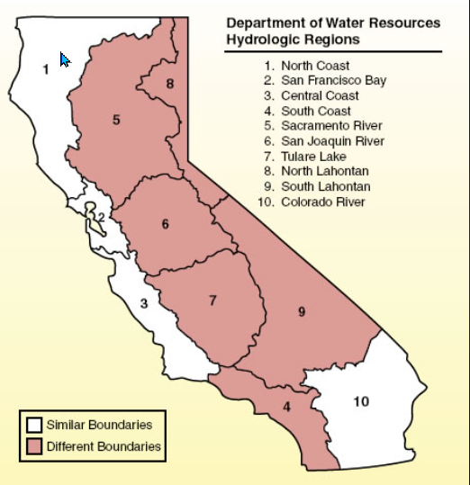
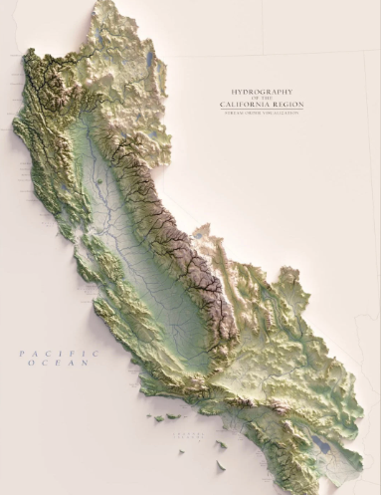
California Hydrologic Regions

Slide 4
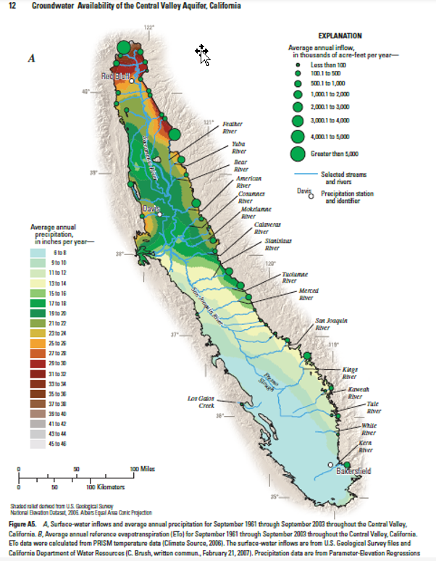
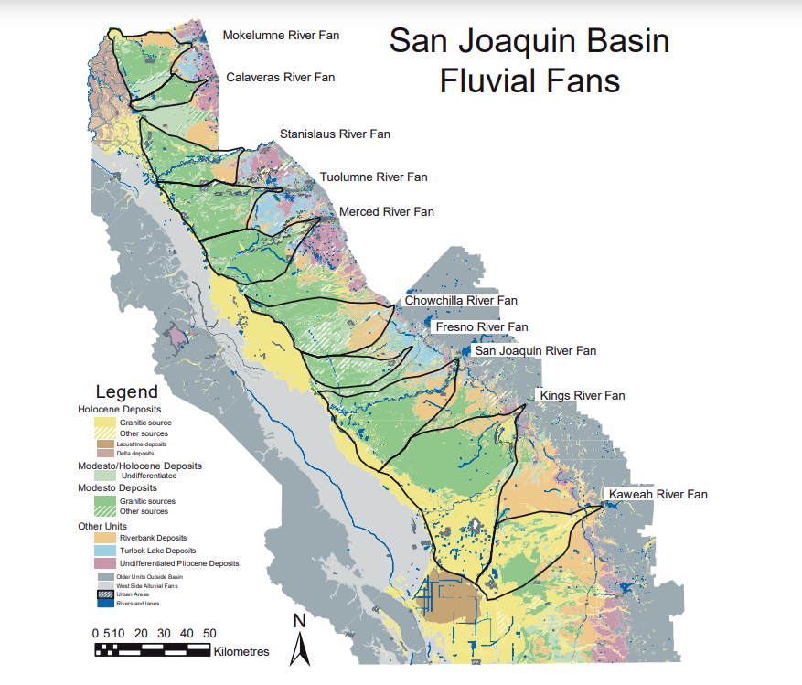
Rain Curtain @ Madera County
Annual Rain Fall 10.7”
Water Shed
River In-Flows
Greatest Distance of any Sierra Headwater River
Not Headwater Rivers

Slide 5
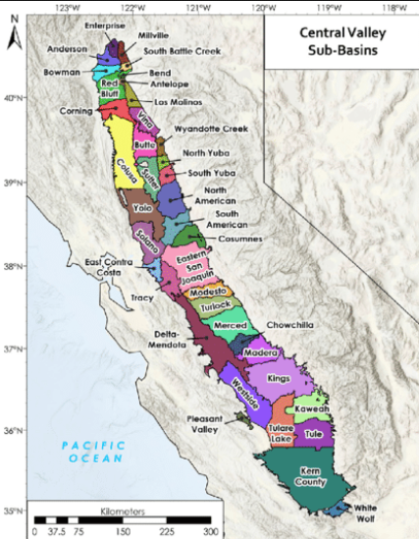
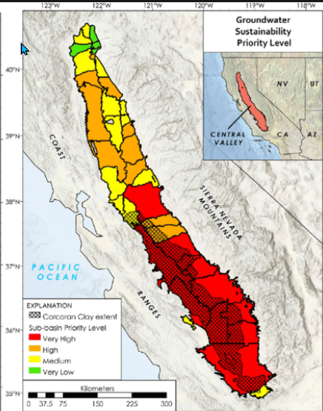
California Hydrologic Sub basins

Slide 6
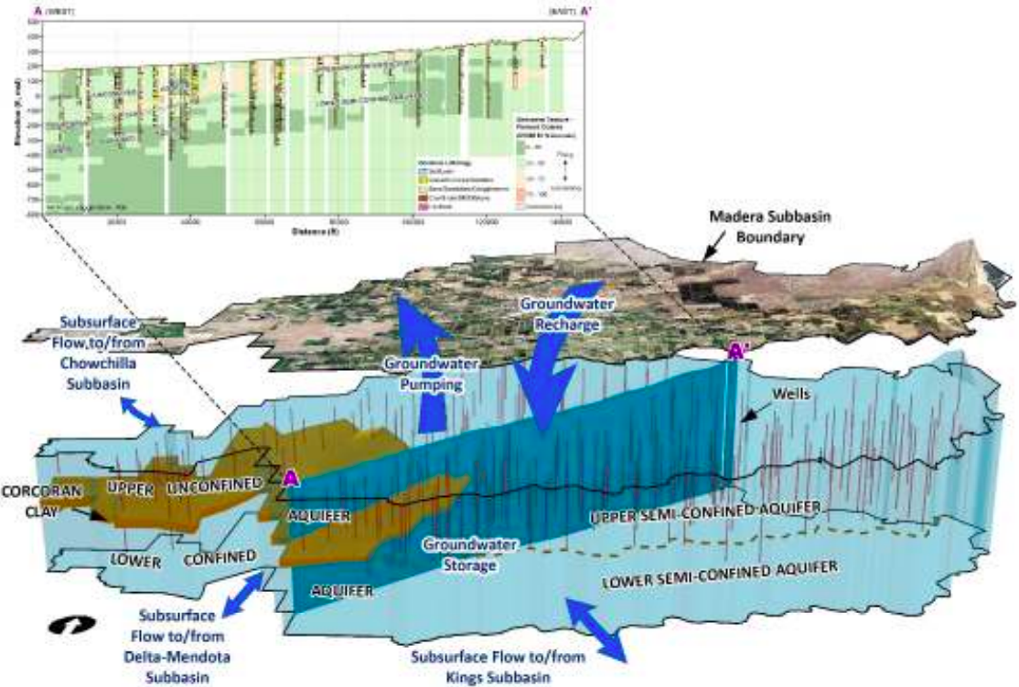
Madera Subbasin 160 foot Hydrologic Gradient E to W
-160 ft elavation
East to West
Highway 41 to Rd 12
Total Basin is 347,667.39 Acres, 259,000 Irrigated. An accumulated use with Ag and Urban 815,547 Ac ft. 98% is Ground Water

Slide 7
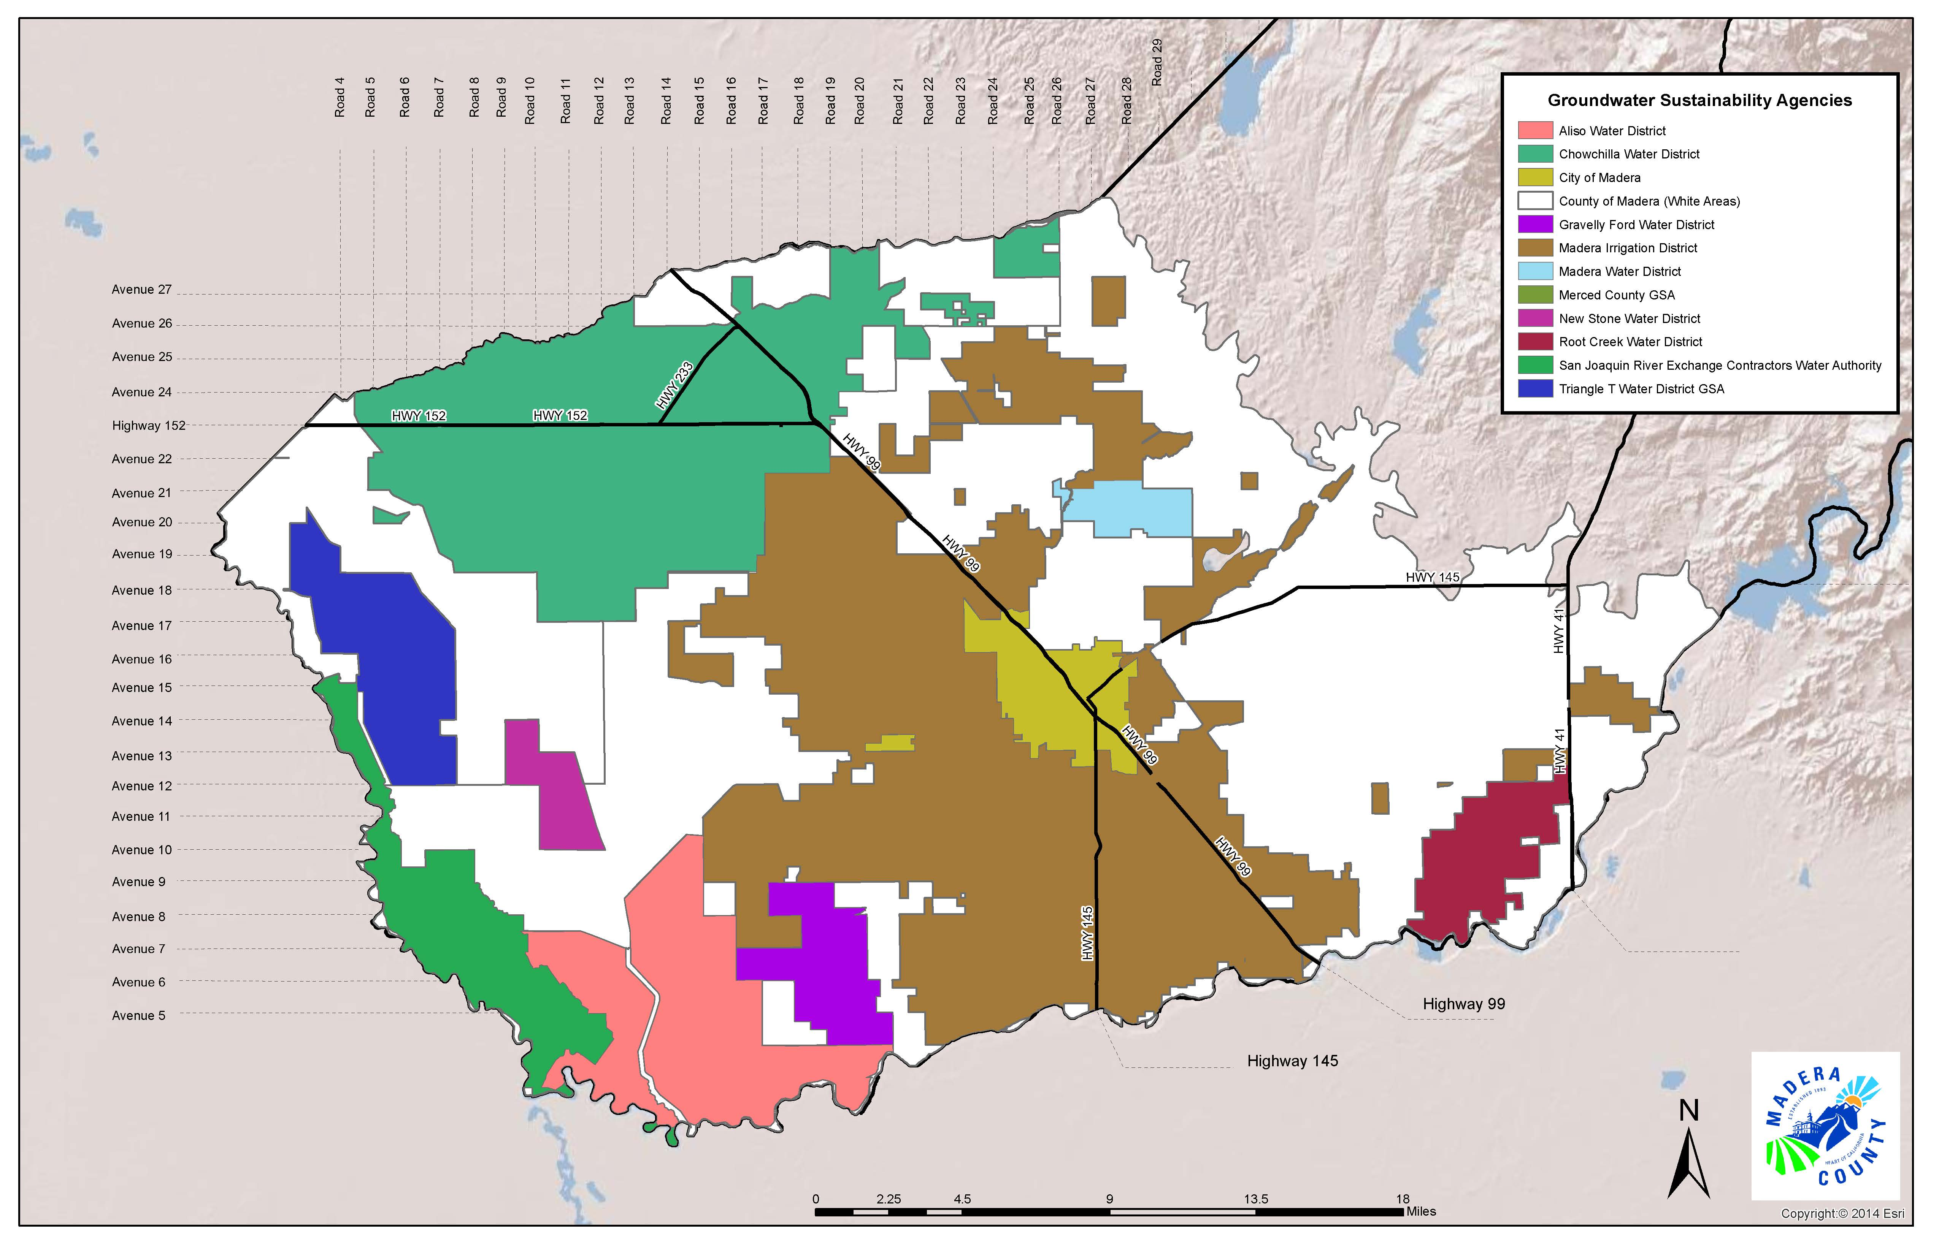
Madera County
3 Sub Basins
12 GSA’s
Madera County Managing 3 Sub basins and 12 GSA’s
Madera
Chowchilla
Delta Mendota
Madera Subbasin (7)
Madera County GSA
Madera Irrigation District GSA
City of Madera GSA
Madera Water District GSA
New Stone Water District GSA
Gravelly Ford Water District GSA
Root Creek Water District GSA
Chowchilla Subbasin (4)
Chowchilla Water District GSA
Madera County GSA
Merced County GSA
Red Top Water District GSA
Delta Mendota Subbasin (3)
Aliso Water District GSA
Madera County GSA
Exchange Contractors (Columbia Canal Company)
Map 1

Slide 8
Challenges Facing Groundwater Overdraft in Madera County
Madera County manages 3 subbasins and 12 GSA’s making the most fragmented SGMA region in the state- with conflicting policies, competing water rights and no unified data system.
50% of Production wells lack flow meters and where flow meters exist many are nonoperational The fix is a county network collecting real time data.
There are only 4 operational CASGEM State Monitoring sites and are disproportionally placed that serve 347,000 acres of very diverse hydrologic zones – leaving our most important asset –groundwater - to models without measurement is theoretical guess work and financial suicide.
Path Forward
Universal continuous measurement in all production wells.
Support a networked a SCADA system that can objectively verify groundwater levels.
Prioritize Hydro Zones and localized strategies to reflect the true granularity of aquifer performance

Slide 9
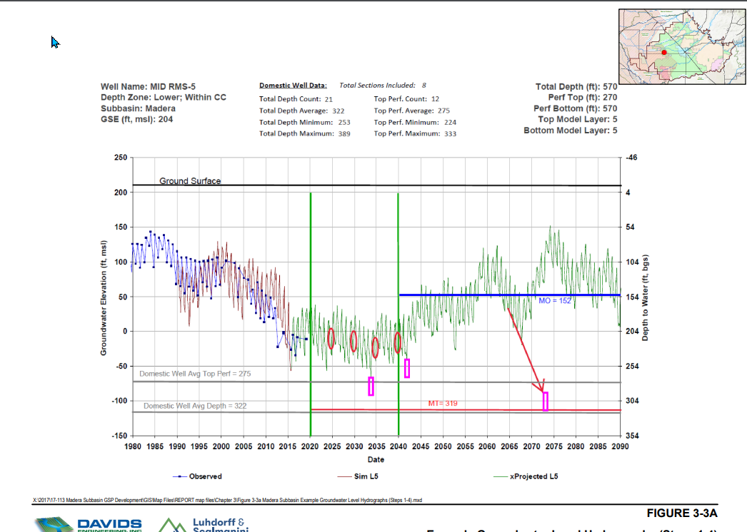
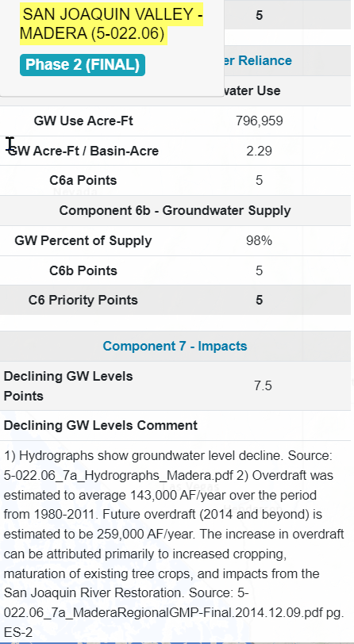
Current Models that Challenge Managing Groundwater Overdraft
In 2040 SWL is @ 322 ft…..From 2014 a loss of 200 ft
Then in 2060 SWL a 100ft increase in groundwater level ???
Is this after Adjudication? or Family Farms going broke?
DWR Score Card 5 = F
Declining GW Level 7.5 Impact

Slide 10
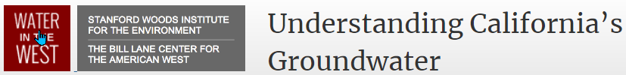
Groundwater Data: “Water of the West “ California’s Missing Metrics
Groundwater data are the critical foundation for decision makers both to prevent problems and formulate solutions
9 out of 10 Hydrologic regions in California receive a failing score when it comes to collecting and sharing
groundwater data
California prohibits sharing of critical groundwater metrics and pumps more groundwater annually than any other state in US …nearly 1/5 of all groundwater
Jay Famiglietti is a global authority on groundwater monitoring and translating cutting-edge science into to mainstream awareness and policy influence.
“ Imagine having a checking account, never keeping track of withdrawals and not worrying about the declining balance. As irresponsible as this may sound, it is Groundwater withdrawals that must be monitored, levels continuously measured, and statewide and regional targets set and met.

Slide 11
Creating Hydro Zones – “Achieve Granularity and Higher Resolution in the Subbasin”
DWR uses Hydrologic Regions and Subbasins to define geologic and water relationships. Breaking Subbasins into Hydro Zones give stakeholders higher resolution to understand groundwater, enabling targeted actions, accurate budgeting and efficient resource use and allocation.
Why… Characterize Subbasins to Hydro Zones
Enhanced Data Accuracy
- Improves spatial understanding of aquifer variability by integrating well performance, soil properties and crop demand.
Supports Adaptive Management
-Enables dynamic response to changing condition through zone-specific monitoring and resource allocation.
Drives Stakeholder Engagement
-Provides growers, water managers, and policymakers with localized insights that build trust and I mprove decision-making
Intergradation into Management Plans

Slide 12
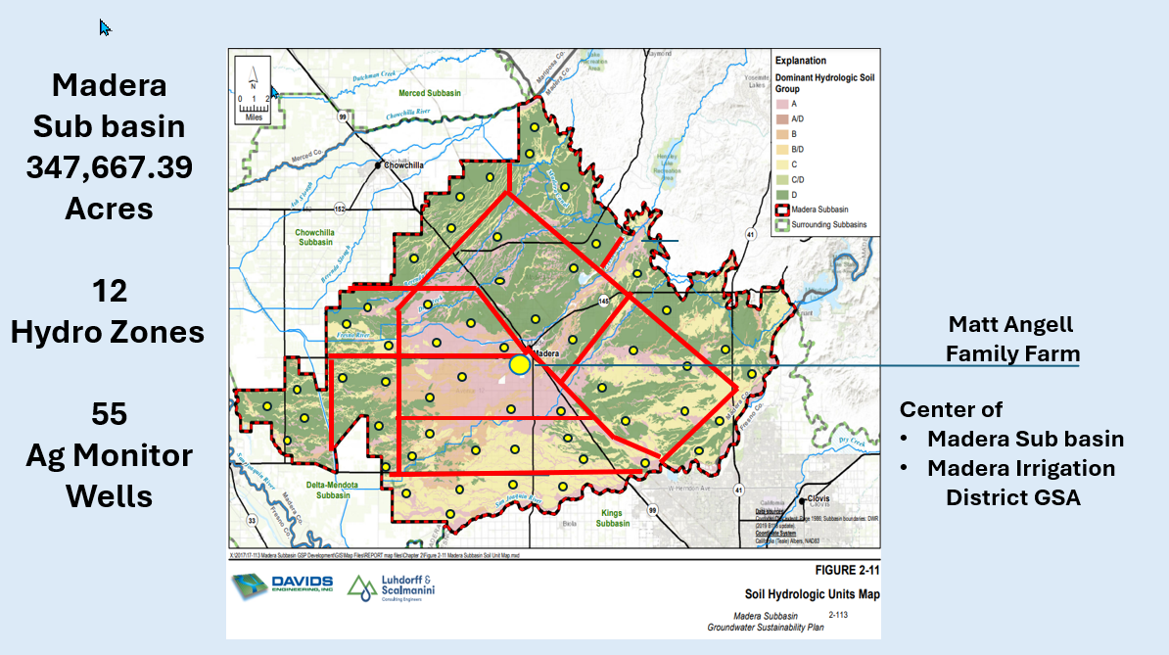
Subbasin Hydro Zones

Slide 13
Defining Hydro Zones requires integration of multiple Tools and Datasets of
Production Wells
Spatial Analysis Crop Planting and Water Demand
Hydrologic Models and Soil Maps
Well and Pump Test Data
-Including Well Development Logs and Step Test and Sustainable 20-year Flow Estimates
Downhole Video surveys
Well Driller’s Logs
A Submersible Down Well Transducer and Data Logger
- for Continuous Measurement of Dynamic Water Levels and Aquifer Conditions
The yield (recovery) of a production well offers the most reliable indicator of an aquifer's resilience and long-term sustainability.
*Hydro zones identify the heterogeneity (differences) of hydrological characteristics within a Subbasin

Slide 14
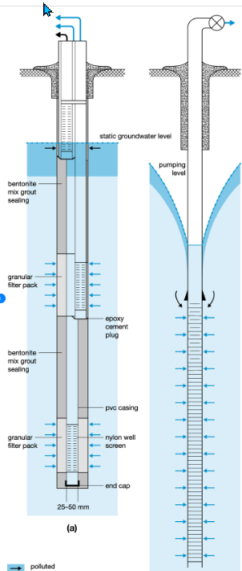
Water Well Submersible Pressure Transducer and Data Logger
The challenge is to “visualize” or characterize Sustainable Groundwater.
Continuous Measurement of a
Submersible Down Well Level Transducer:
Provides critical insight to permanent groundwater decline and critical groundwater dynamics use patterns.
Targets can be set and implemented using Real Time Management Strategies that now can be trusted to address the causes of groundwater overdraft.
Level Transducer
Standing Water level
Pumping Water Level
Pump Set

Slide 15
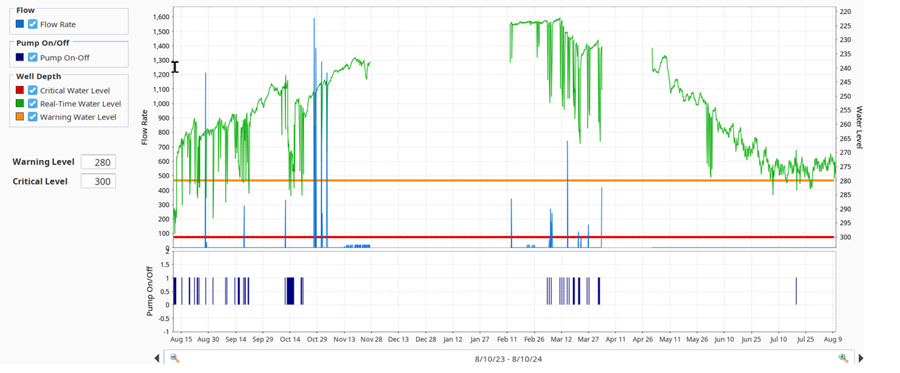
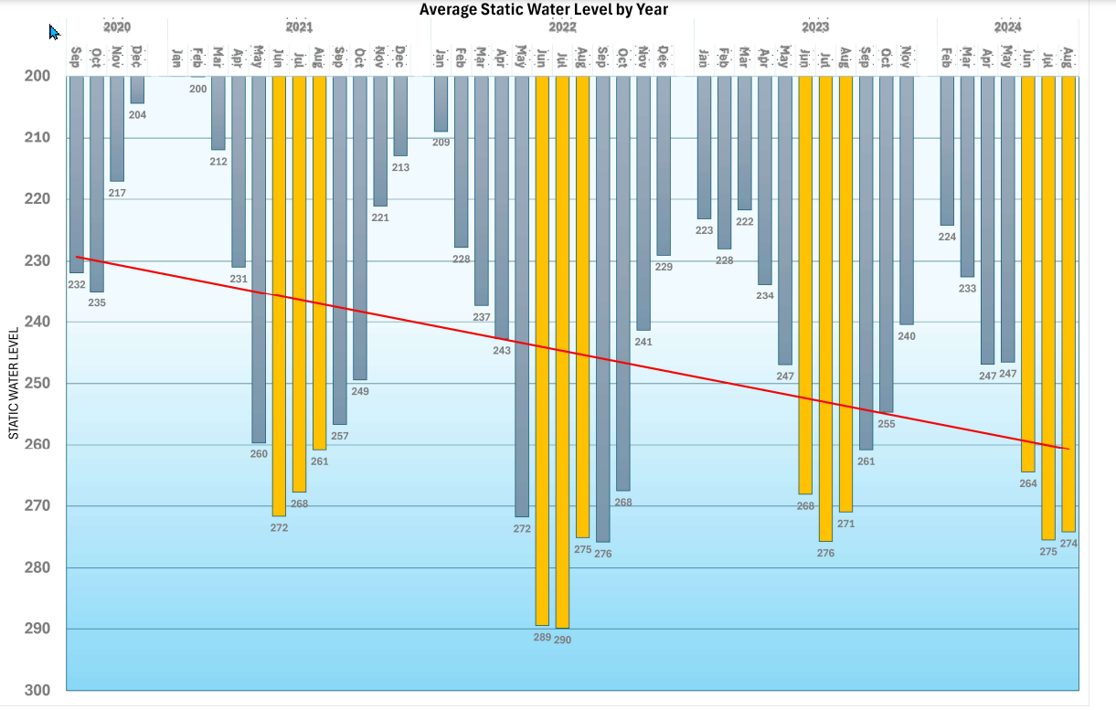
Implementing Sustainable Water Management
One Year Continuous Data:
Flow and Groundwater Level
Water-Informatics Matt Angell Family Farms
4 Year Average Continuous Data: Groundwater Level
Water-Infor-Informatics Matt Angell Family Farms
2023 MID put in 400,000 ac ft
Historical recharge
Average GW Overdraft was
5 ft per year over 4 years

Slide 16
A Model of Collaboration
Madera is one of a few counties in California that prohibits out of –County water transfer
“ Our water is not for sale”
Real- Time well monitoring empowers us to have transparency and cooperation
Proves Sustainability
Prevents Government Intervention
Builds Trust between neighbors
Protects Land Values and Water Rights
An Example of Collaboration “Santa Barbara Bay Oil Derrick Removal”
In Santa Barbara 13 community groups couldn't agree on how to remove Chevron Oil Derricks in the Bay.
Structured a Stakeholder Questionnaires: After 4 rounds of honest input, they reached full consensus
People want to be heard- and when you ask the right question, the answers become obvious

Slide 17
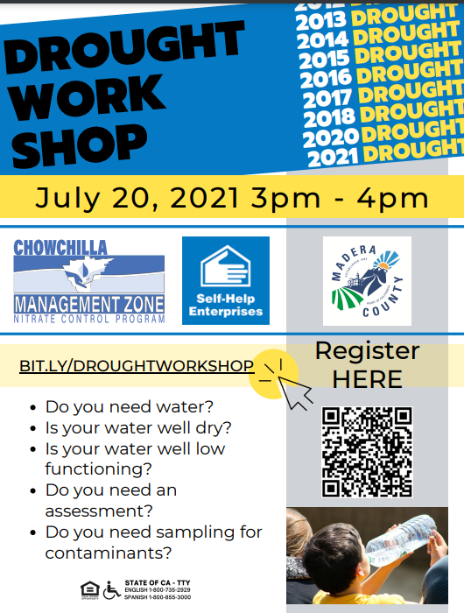



SGMA is not the Demon. Groundwater Over Draft is the Monster
Denis Prosperi, often referred to as "The Oracle"
in Mark Arax's book The Dreamt Land
He is renowned for a pivotal role in preventing Enron Corp from exporting water out of Madera County
In 2016 Denis Prosperi sold all his farm ground and stated
“Trying to reason with local Farmers and Politicians” is a “Race to the Bottom”
Jay Famiglietti, a world renowned authority of hydrology and professor the University of Arizona
"My fear is that by the time SGMA is fully implemented, it will be too late. There will be nothing left to manage."

